Slide 1
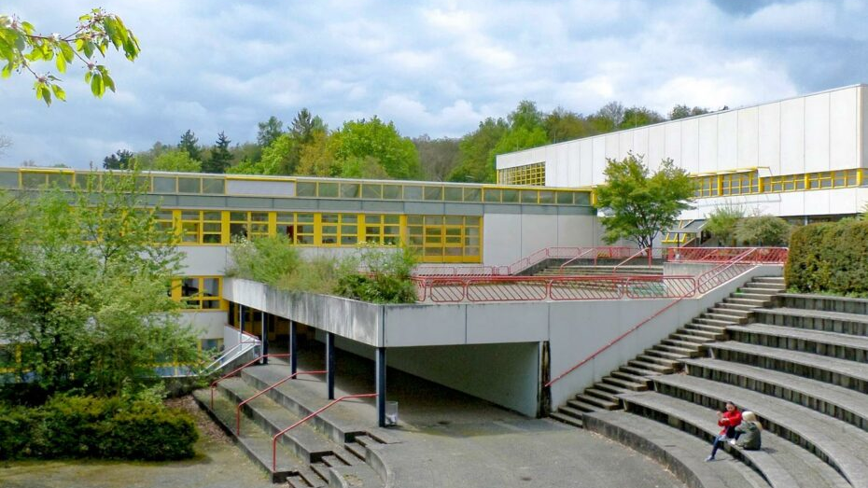
Social Competences at the GTO
By Alexander, Miriam, Lina, Fynn and Malin

Slide 2
Outline
Mediators
School paramedics
Prevention projects
Orientation of 5th graders
Forrest jump
Godparents
Ladder jump
Social competence training

Slide 3
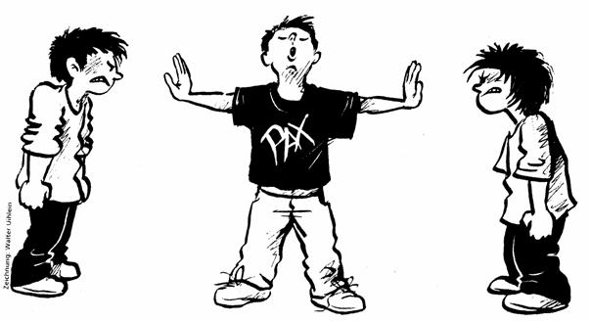
Mediators
Help (mostly younger) students solve arguments
3 day seminar + test to become a mediator
Step by step technique
-> emphasizing with each other
-> mirroring
-> differentiate: what am I feeling – what actually happened
"how do my actions affect the other person?"
Contract at the end (what will we change?)
-> everyone included signs

Slide 4
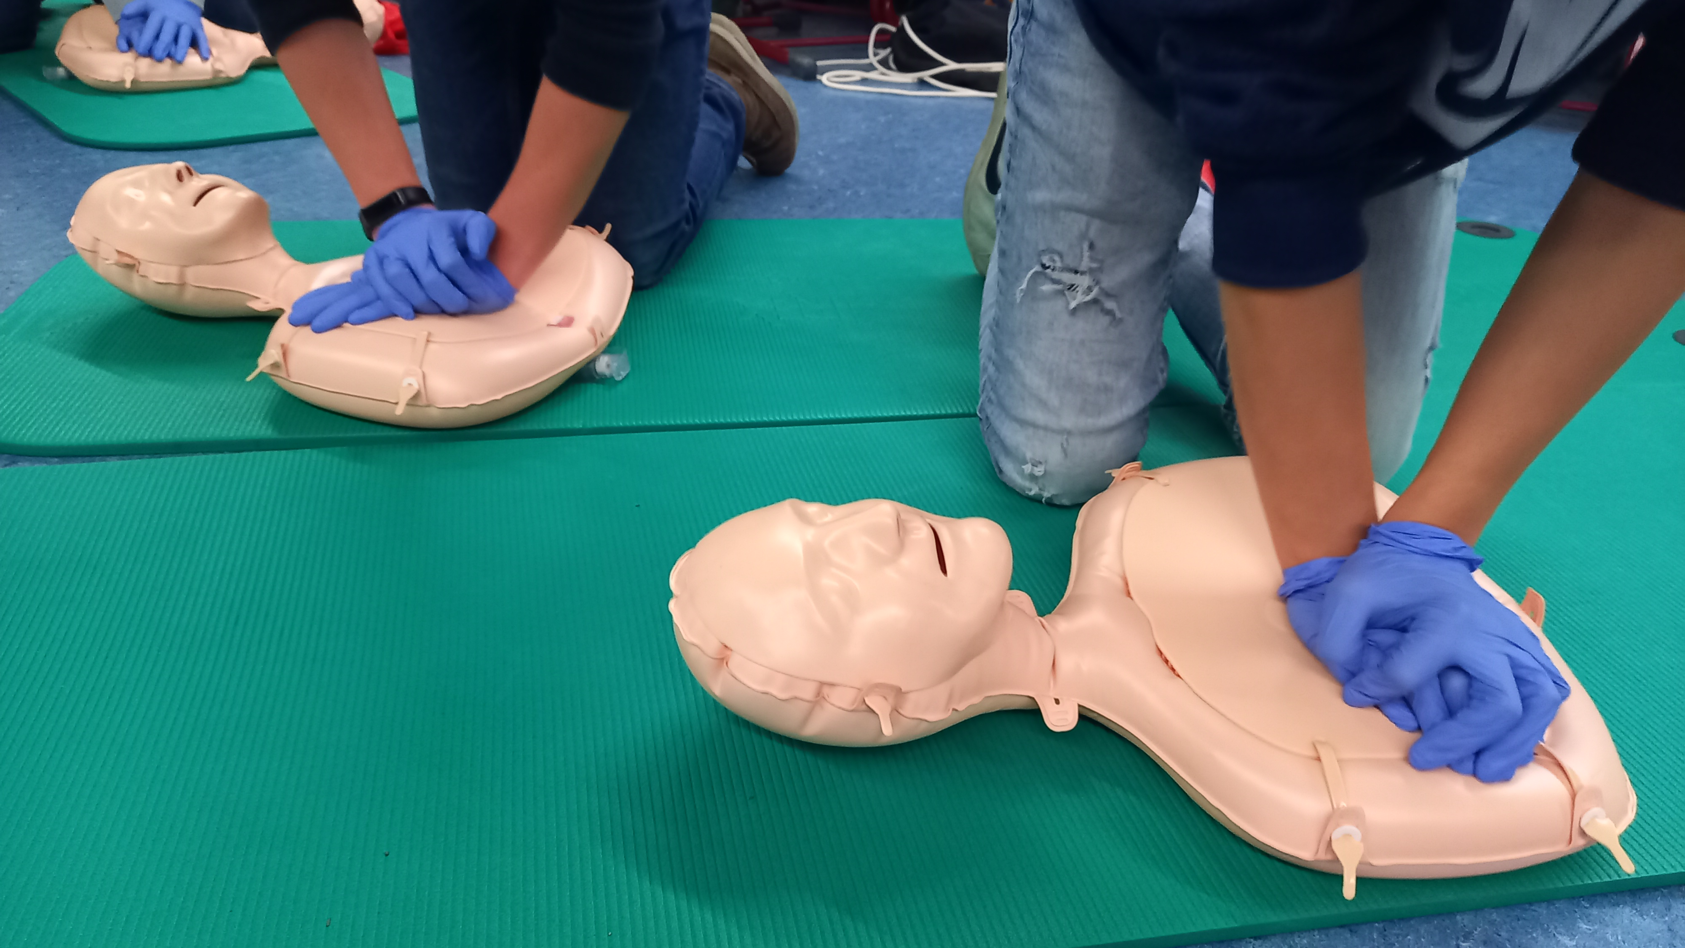
School paramedics
Voluntary class – once a week
Learn & practice what to do in emergencies --> test at the end of the year
Students take turns in being "on call" in case of injury

Slide 5
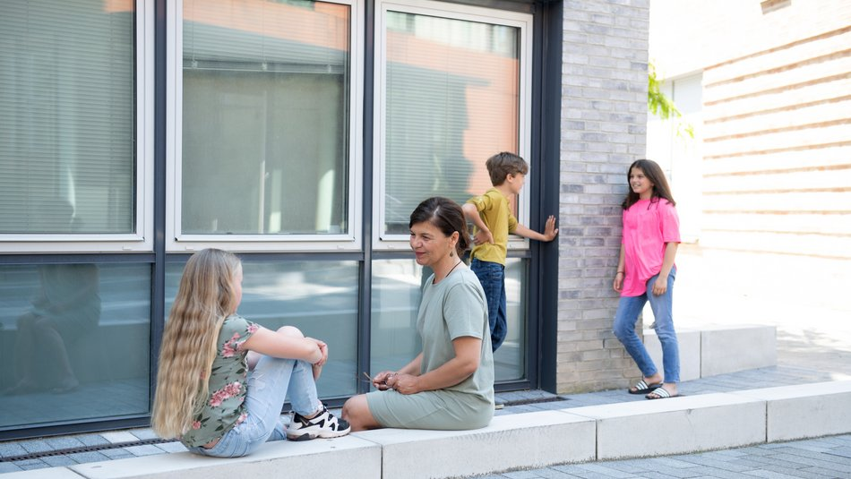
Prevention concepts
Stark, Stärker, Wir (strong, stronger, us)
-> motto of the schools in Baden Württemberg for prevention for violence, addiction and about getting healthier
-> Goal is to set those values from 5th grade on
5th grade:
-> prevention programs for media safety (data protection, social media, cyber mobbing, etc.) through a media agent
6th grade:
-> project media – dangers in the net focus on social media usage and its danger through the police
-> offer for the parents to get the same program

Slide 6
Prevention concepts
7th grade:
-> main focus : addiction prevention – both in the lessens themselves in projects but also trough extracurricular sources : Police, etc. (parent seminar)
8th grade:
-> opportunity to take part in the project "Wehr dich- aber richtig" (Defend yourself- but right) for violence prevention
9th grade:
-> "Fitness and healthy day" - day to show the students how to connect healthy diet, sport activity and healthconsicous action
Be smart - don’t start:
-> contest for 6th to 8th grade to stop kids from smoking

Slide 7
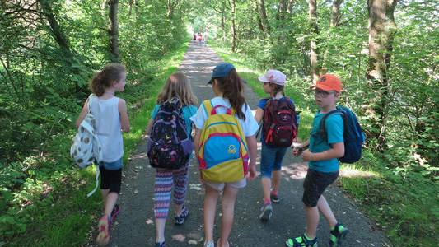
Orientation of 5th graders
in the 5th grade you go for 3 days with the class teachers and all students to a youth hostel (mostly in the first weeks of school)
The community of the class is strengthened by games
The class speakers are elected --> after the students have gotten to know each other better
It is cooked and eaten together

Slide 8
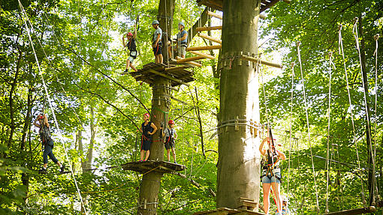
Forest jump
in the 7th grade
trust between students (class community)
going beyond one’s own limits (e.g. fear of heights)
→Procedure: jump from a tall tree and the class and a supervisor secure you with the help of a rope

Slide 9
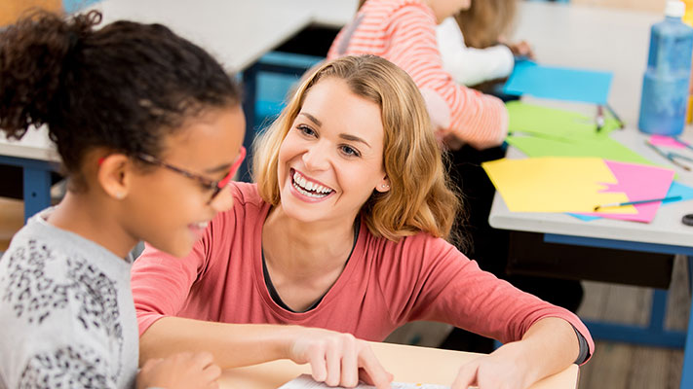
Godpartents
Each new 5th grade gets several older students assigned as so-called godparents
The godparents help the new students to find their way around the school and are open to all questions
They spend time with the 5th graders again and again on the school day

Slide 10
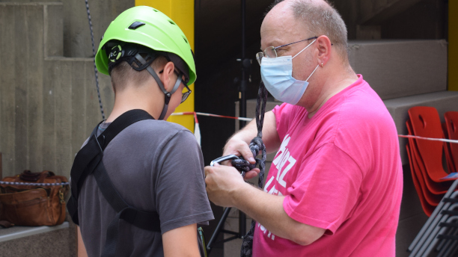
Ladder jump
There is a possibility to jump from a high staircase at the GTO.
It is performed again and again by classes in order to strengthen the cohesion.
→ Procedure: one person climbs up a ladder attached to the stairs with a harness and helmet and the class secures the person with 2 ropes, the person can jump when he is ready and is stopped by the class before he hits the ground.

Slide 11
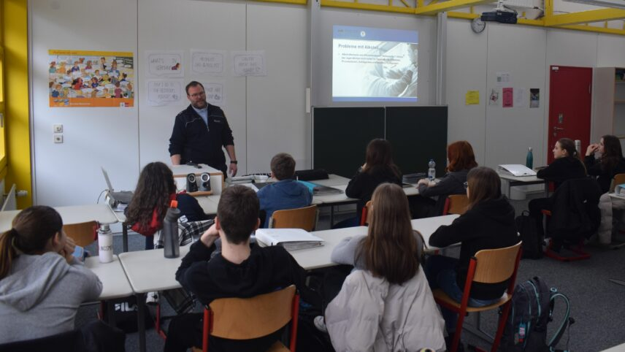
Social competence training (Theory)
Goal: Strengthen the competence to act purposefully and in a task-oriented manner
The so called “Handlungskompetenz” is made up of three skills
- competence of knowledge (retrieve acquired knowledge)
- Methodological competence (acquiring knowledge oneself and communicating this to others)
--> these are mainly taught by school
- Social competence (ability to work in a team, empathy, manners, conflict management...)
-> this is not so clearly conveyed through the lessons, so this is where the "social skills training" comes in

Slide 12
Social competence training (Theory)
- many factors influence social behavior (e.g. parents, family, friends, school, social media...)
--> you have to compete against these factors, i.e. educate and also work together with e.g. parents (e.g. letters to parents, information events...)
- make training as interesting and long-lasting as possible (sense of adventure, group challenges, sense of achievement, debriefing with praise).
- succeeds best with "adventure games”
- Set the group experience in a fictional world of adventure
- accommodate young people's urge to move
- gives participants a sense of achievement that they have achieved as a group

Slide 13
Social competence training (Theory)
- the moderation is crucial for the children's motivation; there are three possibilities here:
-> real: exercises are explained briefly, succinctly and straightforward
-> imaginative: exercises are explained in a fabulous and imaginative way
-> isomorphic: exercises are presented as metaphors
- the type of moderation is very important and must suit the children and the type of training (e.g. for adventure games, an imaginative moderation fits very well)

Slide 14
Social competence training
- is mostly done in grade 5
Reason: the pupils come to the grammar school together from many different primary schools, most of them do not know each other and so this contributes to a good class community
- the training can last from one afternoon to a whole school day
- optimally, the day is started with a joint breakfast or a joint lunch
- the training is devided into 5 steps:
1. Get to know each other (5 – 15 minutes)
-> typical games where class and coaches get to know each other

Slide 15
Social competence training
2. Warm-up exercises (10 - 20 minutes)
-> Among other things, sporting games such as different types of "catch" to break the ice and make contact with classmates
3. Group dynamic exercises (90 – 120 minutes)
-> Confidence and cooperation exercises
-> Several exercises, starting with small groups, which then get bigger and bigger until they become a large group until the group is one big group at the end

Slide 16
Social competence training
4. Closing phase (30 – 40 minutes)
-> a reflection takes place with the help of appropriate games
-> how was the day, what was fun, what was bad?
-> Formulation of goals and rules for the coming time in the class, these are written on a large poster and hung up in the classroom
5. Review
-> After a few weeks, the goals are reviewed with the help of the class teacher and the situation in the class is discussed

Slide 17
Thank you for your attention!

